Slide 1
ENGINEERING TECH TALK · AUGUST 2026
The Agent-Driven SDLC
How LLMs, agents, and the Model Context Protocol are rewiring how we build software — and what we must build to do it well at scale.
The arc: models → agents → protocols → foundations → purpose.
August 2026 · Sources: Stanford HAI · Menlo Ventures · Google DORA · S&P Global · Gartner · Atlassian · Artificial Analysis · Anthropic / Linux Foundation
Notes:
Welcome. Today we walk the full stack of the agent-driven SDLC: what LLMs actually are and where the landscape stands, how agents work, a deep dive on MCP, what we need to govern and build to scale this, and why it matters.

Slide 2
AGENDA · FIVE SECTIONS
The path from models to agents at scale
1
LLMs today
How large language models work, and where the landscape stands today.
2
Agents
How a loop turns a model into a system that does actionable work.
3
MCP deep dive
Why Model Context Protocol servers are changing the game.
4
Preparing for scale
The governance and data foundations to put in place now — graph, vector, and context you own.
5
Why it matters
The opportunity: use AI for the right reasons, and build a more human-centric way of working.
Notes:
Roadmap — frame it as a journey the audience walks with you. First we ground everyone in what a model actually is, so the rest is demystified. Then agents: the leap from a model to a system that does real work. Then MCP: the wiring that connects agents to everything else. Then the preparation: what to build and govern NOW so this works at scale — the section with homework in it. And we end with why: the opportunity to do this for the right reasons. Tell them where the payoff is: sections 4 and 5 are what they can act on this quarter.

Slide 3
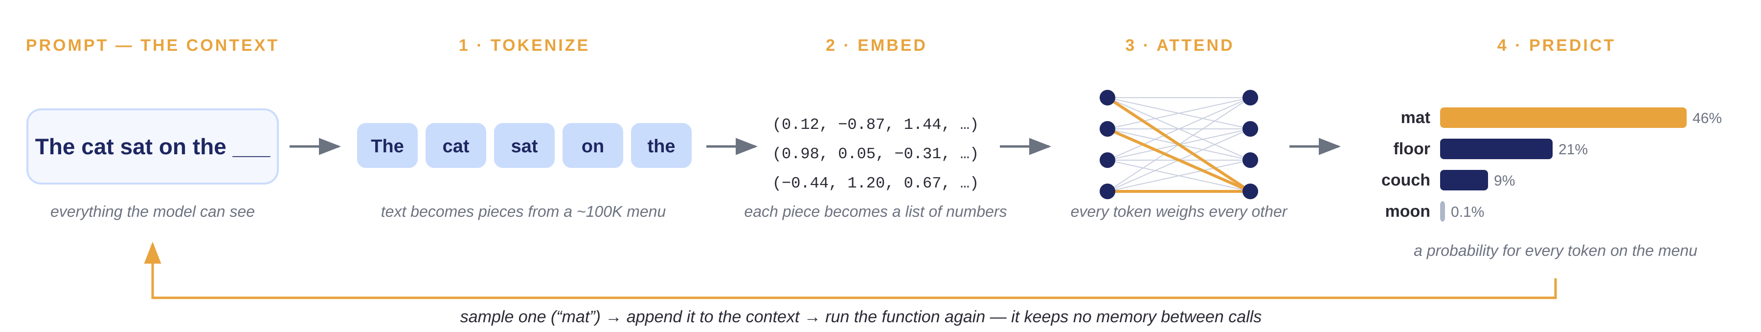
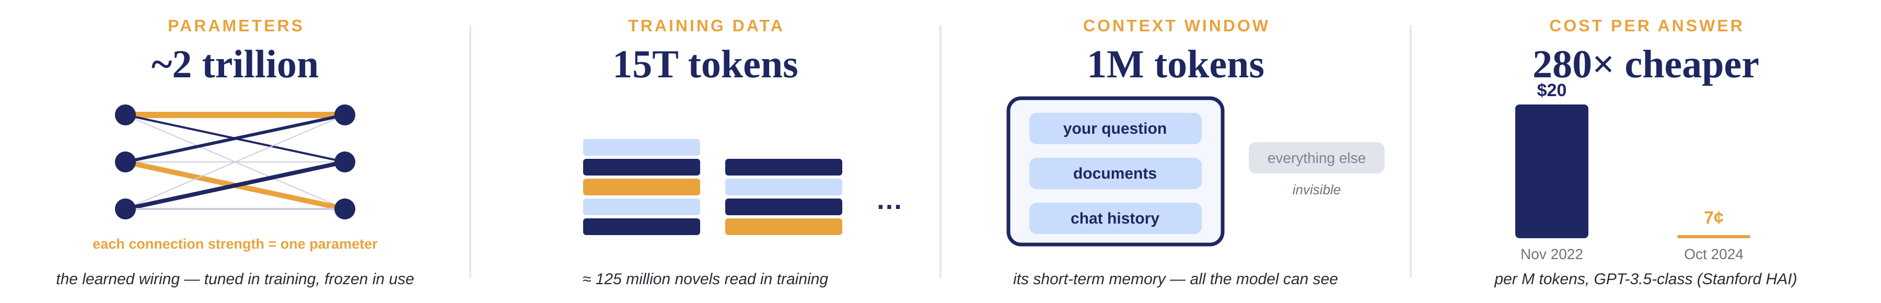
SECTION 1 · WHAT ARE LLMS
LLMs are stateless, bounded, and probabilistic
The whole machine is one forward pass: f(context) → P(next token)
Notes:
This slide makes one point: an LLM is a single forward pass — f(context) in, a probability over the next token out. Stateless, bounded, probabilistic.
Walk the pipeline left to right. The prompt is the context — all the model can see. Tokenize: text chops into pieces from a fixed ~100K menu (a token is a word-piece: 'insurance' is 1 token, 'reinsurance' is 3; one token is about three-quarters of a word — context limits and pricing are both measured in tokens). Embed: each piece becomes numbers. Attend: every token weighs every other (gold = strong connections). Predict: a probability for EVERY token on the menu — it places a bet, it does not look things up. The gold loop: sample one, append, run again — NO memory between calls; 'chat memory' is the app re-sending history each turn.
Metrics strip, one beat each. Parameters: 2 trillion learned connection strengths — tuned in training, frozen in use. Training data: 15T tokens, about 125 million novels. Context window: its short-term memory — your question, documents, chat history; outside the window is invisible. Cost: $20 to 7 cents per million tokens in two years (Stanford HAI) — the second bar is drawn to scale.
Bridge to agents (spoken): a stateless, bounded, probabilistic function cannot do real work alone — wrap it in a loop and it can. That is an agent.

Slide 4



SECTION 1 · THE MODEL LANDSCAPE — AUGUST 2026
The gap for a single “best” AI model is closing — pick by specialty and cost
Today's leading models on the standard scoring index
Model specialization is evolving
Like traditional ML models before them, LLMs are specializing.
Artificial Analysis Intelligence Index — every model takes the same math, science, and coding tests; one 0–100 score.
CODING & AGENTS
Claude Opus 5 — Scores 86.7% on real engineering tasks¹. The engineer.
DEEP REASONING & RESEARCH
Gemini 3.1 Pro — Answers 94.3% of PhD-level science questions². The researcher.
GPT
EVERYDAY GENERALIST
GPT-5.6 Sol — Handles text, images, and voice. The all-rounder.
xAI
COST EFFICIENCY
GPT-5.6 Luna · Grok 4.6 — Near-frontier quality at a fraction of the price. The bargains.
OPEN WEIGHTS — RUN IT YOURSELF
Kimi K3 · DeepSeek V4 · GLM-5.2 — Free to download and self-host. GLM-5.2 beats GPT-5.5 on coding³.
¹ Terminal-Bench: real engineering tasks in a terminal · ² GPQA Diamond: graduate-level science questions · ³ SWE-bench Pro: fixing real open-source bugs (GLM-5.2 62.1% vs GPT-5.5 58.6%).
Sources: Artificial Analysis Intelligence Index via BenchLM.ai · BuildFastWithAI · Swfte (Aug 2026).
Notes:
The landscape as of August 2026. Chart: the Artificial Analysis Intelligence Index — same standardized tests for every model, one 0-100 composite; top models land in the high 50s-low 60s because the tests are deliberately hard. Two observations: five different companies, and seven flagships within seven points. Right: like traditional ML before them (vision, forecasting, NLP), LLMs are specializing — Claude Opus 5 for coding/agents, Gemini 3.1 Pro for deep reasoning, GPT-5.6 Sol the generalist, Luna and Grok 4.6 the bargains, and open-weight models you can self-host now beat closed flagships on some coding benchmarks. Takeaway is in the title: pick by specialty and cost.

Slide 5
SECTION 1 · ENTERPRISE ADOPTION — AUGUST 2026
AI adoption has outrun AI trust
AI is a budget line now
88%
93%
Enterprise gen-AI spend (Menlo Ventures)
of organizations already use AI (Stanford HAI)
of developers already code with AI tools (Atlassian, 6,200 surveyed)
16×
in two years
The gap to close
Use AI today
88%
Govern it well
21%
74% of organizations name inaccuracy as AI’s top risk (McKinsey).
Sources: Menlo Ventures · Stanford HAI · Atlassian · McKinsey · Deloitte (2025–26)
Notes:
(Run the poll from memory: who’s org uses Copilot or any AI? Keep hands up if you used it this week — the room proves the headline.)
Three beats. One: money — the chart’s header IS the takeaway: AI is a budget line now, not an experiment. $2.3B to $13.8B to $37B — 16× in two years (Menlo Ventures). Two: people — 88% of organizations already use AI (Stanford HAI); 93% of developers already code with AI tools (Atlassian, 6,200 developers surveyed) — and 99% of them report saving time every week. Three: the gap to close — 88% use AI, only 21% govern it well — mature controls for autonomous agents (Deloitte), and 74% name inaccuracy as the top risk (McKinsey).
Spoken takeaway for the room: your peers already budget for AI — adoption is no longer the differentiator; governing it well is. Sections 3 and 4 show how.

Slide 6
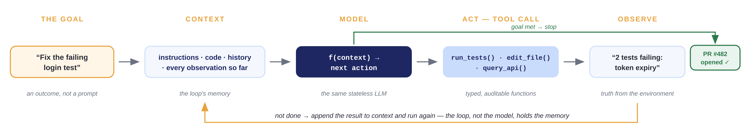
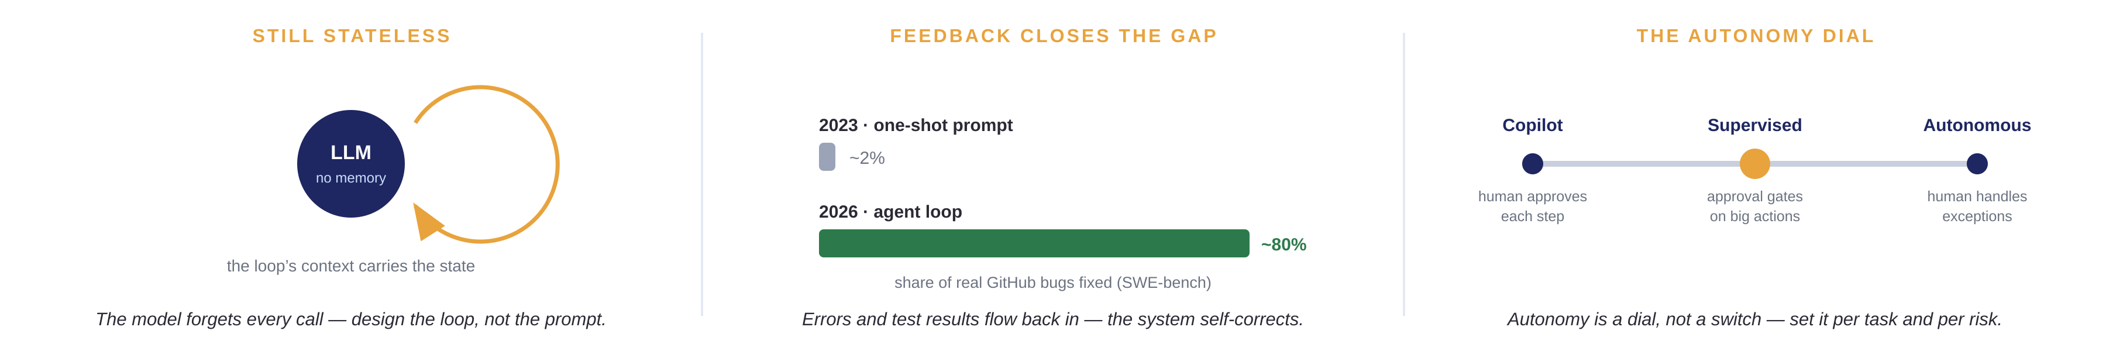
SECTION 2 · WHAT ARE AGENTS
An agent is a model in a loop with tools
The agent loop: while (!done) { act; observe; } — the loop supplies memory, tools, and feedback
Notes:
Callback to the LLM slide: the model is stateless, bounded, probabilistic — it cannot do real work alone. An agent is that same model, wrapped in a loop with tools. The header is the whole idea in one line of pseudocode: while not done, act and observe.
Walk the hero loop with the worked example. It starts with a GOAL, not a prompt: 'fix the failing login test' — an outcome. Everything the agent knows sits in CONTEXT: instructions, code, history, and every observation so far — the loop's memory. The MODEL is the same stateless LLM from section 1: f(context) → next action. It ACTS through tool calls — typed, auditable functions like run_tests(), edit_file(), query_api(). It OBSERVES the result — '2 tests failing: token expiry' — truth from the environment, not from the model's imagination. Gold path: not done → append the observation to context and run again. Green path: goal met → stop and ship — PR opened.
Three supporting ideas. Still stateless: the model forgets every call; the loop's context carries the state — design the loop, not the prompt. Feedback closes the gap: on SWE-bench (real GitHub bugs), one-shot prompting solved ~2% in 2023; agent loops solve ~80% today — self-correction plus better models. The autonomy dial: copilot → supervised → autonomous — set per task and per risk; that dial is exactly what governance in section 4 controls.
Bridge: agents need tools to act. Where do those tools come from, and how do they connect? That's MCP — next section.

Slide 7
SECTION 2 · WHAT AGENTS SOLVE — IN PRACTICE
Agents ship real code, measurably
53%
+19%
18%
of engineering organizations run a coding agent in production (S&P Global)
more merged pull requests per month in agent-assisted repos (Atlassian)
of merged pull requests name a coding agent as author or co-author (2026)
SDLC stage | What agents take on | What stays human
Plan & design | Read the codebase, draft the spec, flag what a change will break | Decide what to build and why
Build & test | Write the code and tests, fix the build — ~9.4 hrs/wk saved per engineer | Review the work; final say on what merges
Operate | Watch dashboards, triage alerts, draft the fix | Own the outcome when things break
Teams of agents: an orchestrator delegates to sub-agents — planner · coder · reviewer — in parallel. 22% of production deployments coordinate 3+ agents, up from 1% in 2024.
Sources: S&P Global Market Intelligence · Atlassian (3,400 repos) · enterprise PR analysis via Digital Applied (2026)
Notes:
This slide answers 'is anyone actually doing this?' — yes, at scale, today.
Top row, all agentic and all output-focused. 53% of engineering organizations run a coding agent in production (S&P Global Market Intelligence). Atlassian's study of 3,400 repos: 19% more merged pull requests per month where agents assist. And 18% of merged pull requests in surveyed enterprises now name a coding agent as author or co-author — agents are shipping, not just suggesting.
The table is the division of labor, in plain words. Plan: agents read the whole codebase, draft the spec, and flag what a change will break; humans decide what to build and why. Build: agents write the code and the tests and fix the build — roughly 9.4 hours per engineer per week saved (composite of Copilot, Cursor, and Claude Code studies); humans review the work and keep final say on what merges. Operate: agents watch dashboards, triage alerts, and draft the fix; humans own the outcome when things break. The pattern to say out loud: agents do the work, humans make the calls.
The navy band: teams of agents are here, not coming. An orchestrator agent delegates to specialized sub-agents — a planner, coders, a reviewer — running in parallel like a small team with a lead. 22% of production deployments already coordinate three or more agents, up from 1% in 2024. Segue to MCP: teams of agents multiply the tool connections you must standardize — which is exactly what the next section solves.

Slide 8
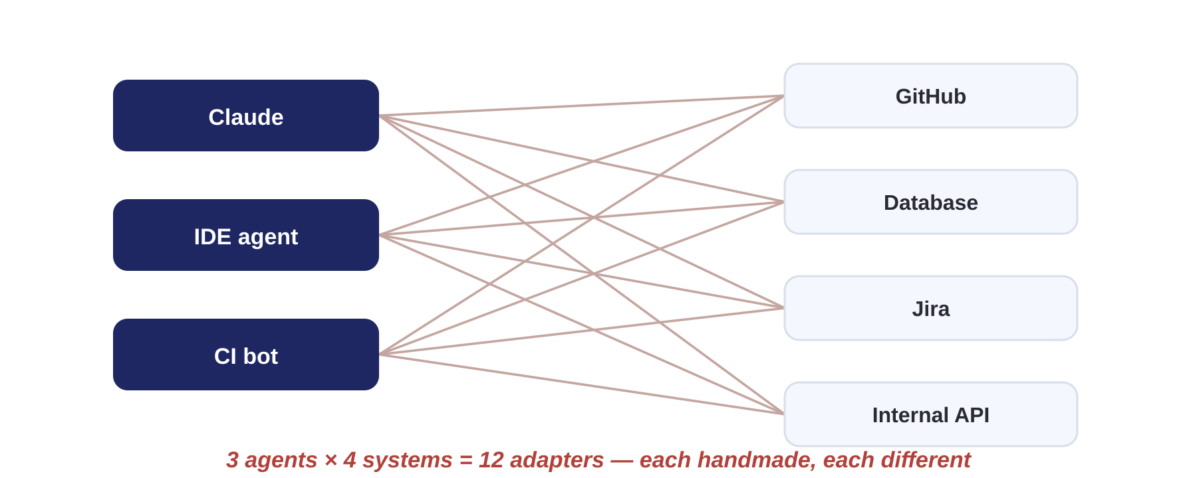
SECTION 3 · THE INTEGRATION PROBLEM
Every AI integration was handmade
To connect ONE agent to ONE system, you wrote:
The result, at just 3 agents × 4 systems:
1
Read that vendor’s plugin spec — different for every agent
2
Write the glue: auth, API calls, data mapping, error handling
3
Describe the tool to the model in that vendor’s format
4
Test and deploy — it works with that one agent only
The lock-in
Every adapter was welded to one vendor. Switching models meant rewriting everything — so nobody switched. Integration debt became lock-in.
5
Repeat for every other agent; rewrite when either side changed
Notes:
State the problem before the solution — the Invisible Ink spine starts here. Once upon a time, every team that wanted AI to touch its systems built the integration by hand. Walk the five manual steps on the left: read the vendor's plugin spec (every vendor's was different), write the glue code — auth, API calls, data mapping, error handling — describe the tool to the model in that vendor's private format, test against that one agent, deploy. Then do it all again for the next agent. And every day, an API changed or a model updated, and something broke.
Right top: even a small shop — 3 agents, 4 systems — is carrying 12 handmade adapters. The tangle is the point.
Right bottom: the deeper cost was strategic, not just engineering hours. Each adapter was welded to one vendor. Switching models meant rewriting everything — so teams didn't switch, whatever the price or quality did. That's lock-in by integration debt.
Cliffhanger to the next slide: until one day, the industry agreed on one shared language…

Slide 9
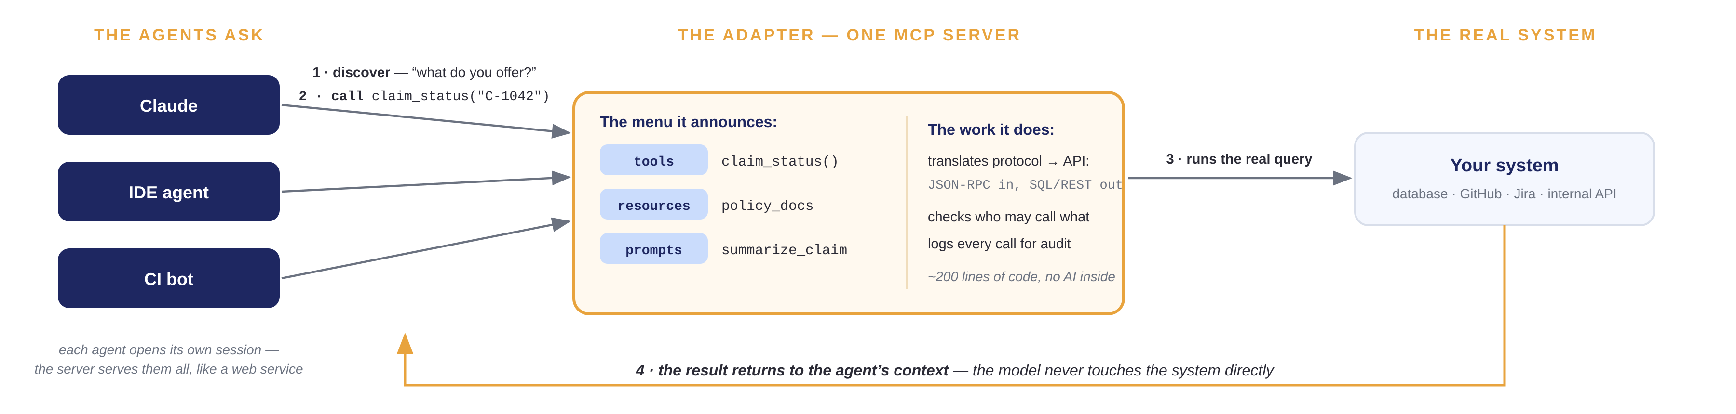
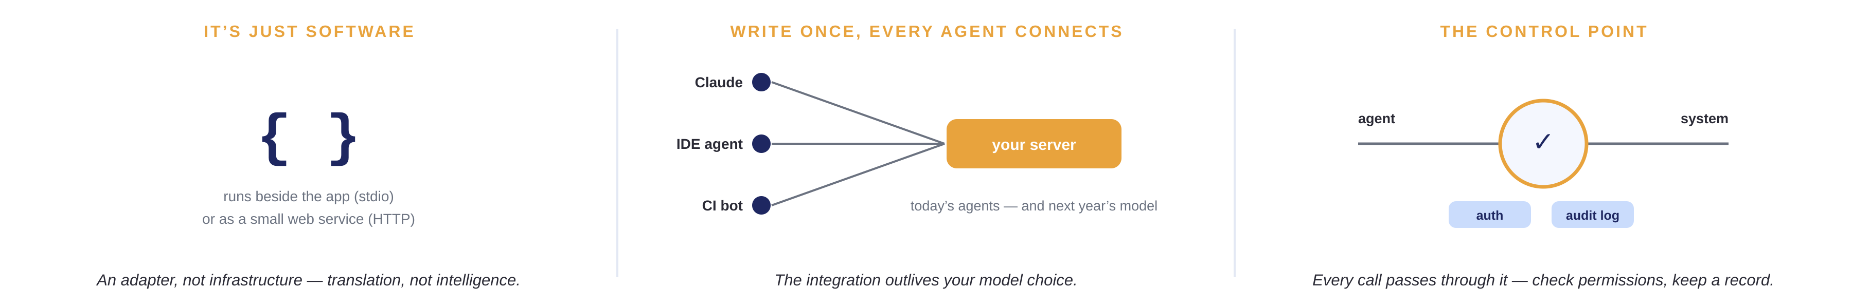
SECTION 3 · MODEL CONTEXT PROTOCOL
An MCP server is an adapter for your system
What it is: a small program that speaks MCP on one side and your system’s API on the other
Notes:
Until one day, the industry agreed on one shared language: MCP. And because of that, you write one small server per system instead of a dozen adapters — this slide is what that server actually is.
Left: many agents, one server. Each agent — Claude, the IDE agent, the CI bot — opens its OWN session to the same server, exactly the way many browsers hit one web service. The server is not paired with an agent; it serves whoever speaks the protocol and is allowed in.
Walk the flow on the top connection: 1 · the agent connects and asks what the server offers; the server announces its menu — tools it can run, resources it can read, prompts it can reuse. 2 · the agent calls a tool, claim_status. 3 · the server translates protocol into a real query — JSON-RPC in, SQL or REST out — checking who may call what and logging every call as it goes. 4 · the result returns to the agent's context. Key sentence out loud: the model NEVER touches the system directly — the server sits in the middle of every call.
Panels: it's just software (~200 lines, no AI inside); write once and every agent connects — the integration outlives your model choice, which kills the lock-in from the previous slide; and it's the control point — permissions and audit live here, which is what section 4 builds on.
Segue: how hard is one to build? Next slide — a complete working server you can copy.

Slide 10
SECTION 3 · MCP — YOUR FIRST SERVER
Your first server: wrap an API you own
server.py — complete and runnable
THE DECORATOR
@mcp.tool() puts the function on the menu
from mcp.server.fastmcp import FastMCP
import requests
mcp = FastMCP("ci")
@mcp.tool()
def build_status(branch: str) -> str:
"""Get the latest CI result for a branch."""
r = requests.get(
f"https://YOUR-CI/api/builds/{branch}")
return r.json()["state"]
mcp.run()
On connect, the server announces it — name, arguments, description. That is the whole registration.
THE DOCSTRING
The docstring is the UI for the model
The agent reads “Get the latest CI result for a branch” to decide when to call it. Write it for a reader, not a compiler.
TAKE IT HOME
Wrap the thing you look up every day
Build status, who’s on call, error counts, the team wiki. Wrap one read-only lookup, plug it in, ask in plain English. Write actions come after governance.
WHAT IT UNLOCKS
$ claude mcp add ci -- python server.py
“Why is main red?” → checks the build → pulls the failing log → drafts the fix
The status page becomes a conversation.
one command plugs it into an agent
Notes:
The point: the barrier to entry is one lunch break, not one quarter — and this is an example to steal.
Left: a complete MCP server that wraps your CI system — twelve lines. (The URL is a placeholder; point it at Jenkins, GitHub Actions, GitLab, whatever you run.) Walk the annotations. The decorator is the entire registration — on connect, the server announces the tool's name, arguments, and description. The docstring is the part people miss: the model READS it to decide when to use the tool — it is the user interface for the model, so write it like documentation for a colleague. Type hints become the schema — branch: str — malformed calls never reach your code.
The take-home, verbatim: wrap the thing YOU look up every day. Build status. Who's on call. Error counts in the logs. The team wiki. One read-only lookup, wrapped like this, one command to plug it in — and that daily portal-login-and-three-clicks becomes a sentence you type. Add write actions only after the governance in section 4.
Bottom right: what it unlocks — 'Why is main red?' The agent checks the build, and because agents chain tools, it can pull the failing log and draft the fix in the same loop. The status page becomes a conversation. Segue: has this scaled beyond hobbyists? Next slide.

Slide 11
SECTION 3 · THE ECOSYSTEM
The ecosystem, 21 months in
10,000+
97M+
41%
active public MCP servers (Dec 2025)
monthly SDK downloads across Python and TypeScript
of software orgs run MCP in production capacity (Stacklok)
Nov 2024
Dec 2025
Anthropic open-sources MCP
Donated to the Linux Foundation
2025
Aug 2026
OpenAI, Google, Microsoft, GitHub adopt
The default way agents reach tools
An open standard — build on it the way you build on HTTP.
Notes:
Until finally, the integration layer became boring — in the best way. 10,000+ public servers, 97M monthly SDK downloads, 41% of software organizations running MCP in production capacity. Walk the timeline: Anthropic open-sourced it in November 2024; through 2025 the rivals — OpenAI, Google, Microsoft, GitHub — adopted it, which locked in the network effects; in December 2025 Anthropic donated it to the Linux Foundation for neutral governance; and today it is simply the default way agents reach tools. And ever since, the interesting question moved from 'how do we connect AI?' to 'what should we let it do?' — which is section 4. Build on it the way you build on HTTP.

Slide 12
SECTION 4 · MAKING IT WORK AT SCALE
Autonomy scales only with governance
Identity & least privilege
1
Agents get their own scoped, revocable credentials — never shared human accounts. Every tool an agent can touch is an access-control decision.
Toolkit: OAuth 2.1 (built into MCP) · workload identity (SPIFFE/SPIRE) · Microsoft Entra Agent ID · scoped service accounts per agent
Observability & audit
2
Log every tool call — inputs, outputs, and who asked. If you can’t replay why an agent acted, you can’t run it in production.
Toolkit: OpenTelemetry GenAI semantic conventions · Langfuse / LangSmith tracing · MCP’s host-mediated calls give you one choke point to log
Evals & guardrails
3
Regression evals like unit tests; policy checks in CI; human approval gates on irreversible actions — merges, deploys, data writes.
Toolkit: OWASP Top 10 for LLM Applications · NIST AI Risk Management Framework · promptfoo / Braintrust evals wired into CI
Cost & capacity control
4
Token budgets per task; route easy work to cheaper models; cache what repeats. Agent spend is a new cloud bill — meter it early.
Toolkit: LLM gateways (LiteLLM · OpenRouter) for routing + budgets · prompt caching · FinOps Foundation guidance on AI unit costs
Take-home references (links in the notes): OWASP GenAI Security · NIST AI RMF · OpenTelemetry GenAI · MCP authorization spec · Langfuse · FinOps Foundation
Notes:
Recall the trust gap: 74% expect agentic AI in production within two years, 21% have mature governance. These four are the minimum bar — and each now names the tools and patterns to start with.
1 · Identity: give every agent its own scoped, revocable credential — never a shared human account. MCP builds on OAuth 2.1 for authorization; SPIFFE/SPIRE handles workload identity; Microsoft’s Entra Agent ID is the same idea in the Microsoft stack. Pattern: least privilege per tool; revoke without collateral damage.
2 · Observability: OpenTelemetry’s GenAI semantic conventions give you a vendor-neutral trace format; Langfuse (open source) and LangSmith record every model and tool call — inputs, outputs, latency, cost. Pattern: the MCP host mediates every call, so you have ONE choke point to log — use it.
3 · Evals & guardrails: treat evals like unit tests — run promptfoo or Braintrust suites in CI on every change. Threat-model against the OWASP Top 10 for LLM Applications (prompt injection is #1); frame the program with the NIST AI Risk Management Framework. Pattern: human approval gates on anything irreversible.
4 · Cost: put an LLM gateway (LiteLLM, OpenRouter) in front of every model for budgets, routing, and one bill; cache repeated prompts; use FinOps Foundation guidance to define cost-per-task. Pattern: meter before it meters you.
Take-home links, share with the room: genai.owasp.org · nist.gov/itl/ai-risk-management-framework · opentelemetry.io/docs/specs/semconv/gen-ai · modelcontextprotocol.io/specification (authorization) · langfuse.com · promptfoo.dev · finops.org.

Slide 13
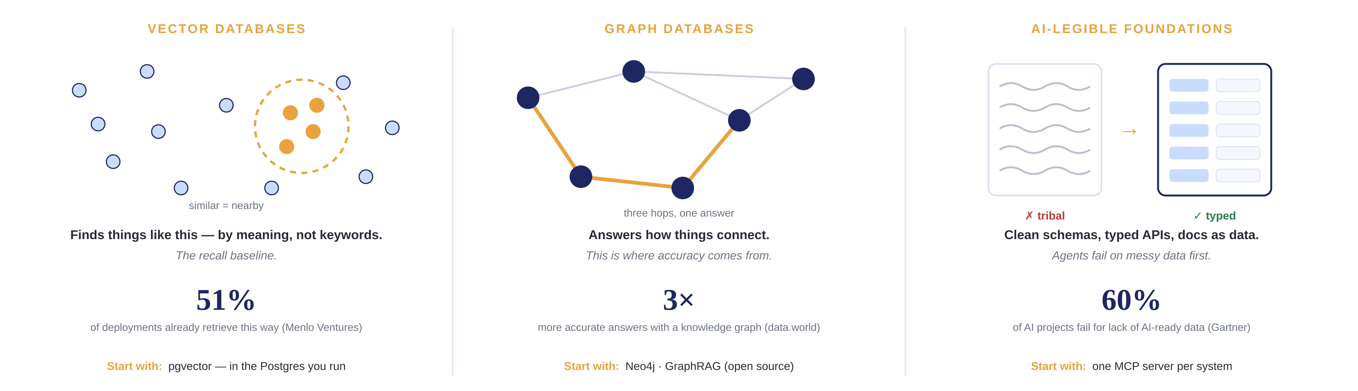
SECTION 4 · FOUNDATIONAL TECHNOLOGY
Build data layers AI can actually read
The winning pattern — hybrid retrieval: vectors recall the candidates; the graph makes the answer accurate.
Who’s ahead: Microsoft (open-sourced GraphRAG) · LinkedIn (support resolution −28.6%) · teams that treat data as a product.
Sources: Menlo Ventures State of Gen-AI · data.world LLM benchmark (arXiv 2311.07509) · Gartner (2025) · LinkedIn GraphRAG study (arXiv 2404.17723)
Notes:
The principle: agents are only as good as what they can find. Three investments — each panel gives the why, the number, and where to start.
Vector databases — the picture: every document, ticket, and code file becomes a dot in space; similar things sit near each other. So an agent finds 'things like this' by meaning, not keywords. But be clear: this is the BASELINE — 51% of enterprise deployments already retrieve this way (Menlo Ventures). Recall gets plausible passages; it does not by itself make answers correct. Start with pgvector — vectors inside the Postgres you already run.
Graph databases — the picture: the gold path is a three-hop question — 'what breaks if we change this?' — something similarity search cannot walk. This is where accuracy comes from: in data.world's benchmark, LLM answers on enterprise data were 3× more accurate with a knowledge graph (54.2% vs 16.7%). Start with Neo4j, or Microsoft's open-source GraphRAG.
AI-legible foundations — the picture: the same information twice — once as tribal squiggles, once as a typed schema. Agents fail on the messy version first. Gartner's warning is the stat: 60% of AI projects through 2026 will be abandoned for lack of AI-ready data — the data, not the model, is usually the blocker. Start by exposing one system as an MCP server with a written contract — the act forces the cleanup.
The winning pattern, from research and practice: hybrid retrieval — vectors recall candidates, the graph makes the answer accurate, both feed context. Who's ahead: Microsoft open-sourced GraphRAG; LinkedIn used it to cut median support resolution time 28.6% (published study); and broadly, the teams that treat data as a product with owners and contracts. Segue: all of it feeds one place — the context window. Next: own it.

Slide 14
SECTION 4 · THE CONTEXT LAYER
Context is the asset. Own it.
Window — finite, and quality decays as it fills (“context rot”)
Switching providers
W
Tools: prompt caching · compaction · context-editing APIs
this year’s
model
⇄
next year’s
model
R
Retrieval — fetch just-in-time; hybrid beats any single index
Tools: pgvector + keyword + graph · rerankers (Cohere)
YOUR CONTEXT LAYER
graph · vectors · MCP servers
M
Memory — persist decisions across sessions — now a product category
Models swap. Context stays.
In vendor features → captive.
In your layer → a config change — and every new model knows your business on day one.
Tools: Mem0 · Zep · Letta · the models’ own memory APIs
P
Portability — keep context in your stores, spoken through open standards
Tools: MCP resources · llms.txt · markdown-as-memory
Get ahead: Anthropic’s “Effective Context Engineering” · Chroma’s “Context Rot” study · 12-Factor Agents · watch the memory layer: Mem0, Zep, Letta, Cognee
Notes:
The section's punchline, and the slide to slow down on — context is the durable asset; models are increasingly interchangeable.
Left column, four disciplines, each with tools to name. WINDOW: the window is finite and quality decays as it fills — Chroma's 'context rot' research showed models degrade on long contexts well before the token limit. Manage it: prompt caching (pay once for what repeats), compaction and context-editing APIs (the providers now ship these natively). RETRIEVAL: fetch just-in-time rather than pre-loading; hybrid — vectors + keyword + graph — beats any single index, and a reranker (e.g., Cohere) cheaply lifts precision. MEMORY: persisting decisions across sessions is now a product category — Mem0, Zep, Letta (from the MemGPT research), Cognee — plus the model vendors' own memory APIs; the strategic question is WHERE that memory lives. PORTABILITY: keep context in your own stores and speak it through open standards — MCP resources, llms.txt for making sites agent-readable, and plain markdown as memory (it survives every vendor).
Right visual: the argument in one picture. Models swap above; your context layer — graph, vectors, MCP servers — stays below. If context lives in one vendor's memory features, you are captive. If it lives in your layer, switching is a config change, and every new model knows your business on day one.
What to think about: who owns the memory store? Can you export it? Does your context survive a provider change intact? Treat those as procurement questions, not engineering afterthoughts.
Go-deeper references (share these): anthropic.com/engineering/effective-context-engineering-for-ai-agents · research.trychroma.com/context-rot · github.com/humanlayer/12-factor-agents · mem0.ai · getzep.com · letta.com. Segue: why does all this matter? Last section.

Slide 15
SECTION 5 · WHY THIS MATTERS
Use AI the right way, for the right reasons
1
Automate the toil. Keep the judgment.
THE AGENT LOOP
Agents do the work; people decide what to build, what merges, and what ships.
2
Own your foundations.
MCP · DATA · CONTEXT
Open standards, your data layers, your context. Freedom is an architecture choice.
3
Govern from day one.
THE TRUST GAP
Identity, audit, evals, budgets. Trust is what lets you grant autonomy.
4
Measure human outcomes.
THE POINT
Not just throughput — better decisions, deeper craft, and room to solve harder problems.
The goal should not be less human involvement — machines absorb the mechanical; people can bring more meaningful work to life.
Sources across this talk: Stanford HAI · Menlo Ventures · Google DORA · S&P Global · Gartner · data.world · Artificial Analysis · Anthropic / Linux Foundation
Notes:
Close by replaying the whole talk as four commitments — each one points back at a section the audience has already seen, so it lands as earned, not aspirational.
One — automate the toil, keep the judgment. That's the agent-loop slide and the division-of-labor table: agents do the work, humans make the calls. The human-centric version: give people back the hours the mechanical middle was eating.
Two — own your foundations. That's MCP, the data layers, and the context slide in one sentence: open standards plus stores you own mean freedom is an architecture choice, not a negotiation with a vendor.
Three — govern from day one. Callback to the trust gap (88% use it, 21% govern it well) and the governance toolkit. Trust is not the brake — it is what lets you responsibly turn the autonomy dial up.
Four — measure human outcomes. The adoption slide proved the spend and the throughput; this is the harder metric: are decisions getting better, is craft getting deeper, and can the team now take on problems it couldn't afford to touch before?
Then the last line, slowly: the goal should not be less human involvement — machines absorb the mechanical; people can bring more meaningful work to life. That is what 'use AI the right way, for the right reasons' means. Thank the room; open for questions.

