Slide 1

CRAFTING AGENT SKILLS
Agents Aren't You
Turning the unwritten knowledge in your Python repo into instructions agents can actually use.
agents · skills · your repo
Notes:
Framing: a skill is procedural knowledge you hand an agent that starts every session with no memory of your team. Three things decide whether it pays off: what it costs to keep around, whether it fires at the right moment, and whether it says anything the model did not already know.

Slide 2
SECTION ONE
Why are we designing for first-class agents?
Notes:
Set up the section in one line: agents are already writing code in this repo, so the question is not whether to let them in, it is what the repo tells them when they arrive. Four slides: what an agent is, how tools and MCP and skills differ, what the measurement says, and what NIST is about to require.

Slide 3
SECTION ONE · RECAP
Recall what an agent is
tool result appended to context
1
tool
calls?
2
CONTEXT
MODEL
YES
TOOLS
what the model can see.
Retrieved just in time, compacted, finite.
the commodity.
It picks the next move.
typed schemas from your signatures.
MCP when the tool is out of process.
NO
3
4
HARNESS
SKILLS
VERIFY
DONE
files, git, checkpoints: state that outlives the window
load in here, on demand
a grader it cannot edit
or back around, with evidence
ERROR COMPOUNDS
TOKENS PER TASK
INJECTION DEFENSES
37%
of 100-step runs finish,
at 99% accuracy per step
chat
1x
agent
4x
71-100% of adaptive attacks get through
multi
15x
Sources: Anthropic engineering on context and agents; The Attacker Moves Second, arXiv:2510.09023.
Notes:
• An agent is not a new kind of model. It is a model operating inside a loop with context, tools, persistent state, and some definition of done.
• The model is only one component. For repository design we have far more control over the context, tools, harness, verification, and skills than over the underlying model.
• Every loop compounds uncertainty. The 37% figure is illustrative math: 0.99^100. It assumes an independent 99% success rate at every step, which real agent runs absolutely do not have. The point is only that small failure rates become meaningful over long trajectories.
• More autonomy usually means more context and tool traffic. Treat the token multipliers as directional, not as universal benchmarks. Agent architectures vary considerably.
• Verification is different from instruction. Telling an agent to write good tests is not the same as giving it a test suite or a grader it cannot modify. Wherever possible, move correctness out of prose and into executable checks.
• Persistent state matters because context is temporary. Files, git history, checkpoints, test results, and artifacts survive after the context window is compacted or the session ends.
• Skills enter the loop through context. They do not make the model intrinsically smarter. They inject repository-specific procedural knowledge at the moment the agent needs it.
• That is the bridge to the rest of the presentation: your agent already knows Python. The repository has to teach it how your team works here.

Slide 4



Tool vs. MCP Server vs. Skill
THE UNIT OF ACTION
THE UNIT OF CONNECTION
THE UNIT OF KNOW-HOW
TOOL
MCP SERVER
SKILL
One action the model can call.
One connection that serves many tools.
One procedure the model follows every time.
A function with a name and a typed input.
The model decides when to call it. Your code runs it.
Every tool sits in context every turn, used or not. Tools cost context.
A program that hands an agent a bundle of tools.
It speaks one protocol, so any host can connect.
Write the integration once. Claude, VS Code, and Cursor all use it.
A folder: SKILL.md, plus scripts and notes if it needs them.
The name is always loaded. The body loads when the task matches.
It adds no new power. It teaches how the work is done here.
add(2, 2) -> 4
math-server -> [add, subtract]
rounding/SKILL.md -> round half up
Answers: what can it do?
Answers: where do the tools come from?
Answers: how should it be done?
MCP servers connect. Tools act. Skills decide how and when. Most real work uses all three at once.
Notes:
The three are layers, not alternatives. A tool is the unit of action: a schema plus a handler, and its schema costs context on every turn. An MCP server is the unit of connection: it serves a bundle of tools, resources, and prompts over JSON-RPC 2.0 on stdio or streamable HTTP, so one integration works across every MCP host. A skill is the unit of know-how: a SKILL.md and its bundled files, loaded progressively, that teaches procedure and judgment without adding any new capability. Common failure mode: teams build an MCP server when what they actually needed was a skill, because the model already had the tools and just did not know the house standard for using them.

Slide 5
SECTION ONE · IN PRODUCTION TODAY
Agents are already writing your Python
~90%
+24%
84.3%
1M+
of developers use AI assistance
more merged pull requests
merge rate, Claude Code PRs
coding-agent pull requests
DORA 2025
Microsoft, tens of thousands of engineers
in Python repos, vs an ~85% human baseline
on GitHub, May to Sept 2025
MERGE RATE IN PYTHON REPOS
AND WHAT THEY LEAVE BEHIND
489 Python repos, 220,612 closed pull requests, 9,227 of them agent-authored.
4,882 agent PRs replayed for coverage; 747 co-active pairs replayed as real git merges.
Agents are already in the repository. We can design the repository to interact back with them.
Sources: DORA 2025; GitHub Octoverse 2025; arXiv 2607.01418 (Microsoft rollout); arXiv 2607.21832 (Python merge rates); arXiv 2607.18057 (test coverage); arXiv 2607.04697 (merge conflicts).
Notes:
Left chart is the one to sit on: agent pull requests in Python repos merge within a point of the human baseline, which means these are not toy patches being waved through. The study is large and Python-only, 489 repos and 220,612 closed PRs, so it is the best evidence we have for this audience. Right chart is the same body of research turned around: the merged code frequently ships with no test touching the lines it changed, and two agents in one repo conflict at double the rate of one. Both are repository problems, not model problems, which is the argument for the rest of the talk.

Slide 6
SECTION ONE · NIST AND AI AGENTS
Why Aren't Agents You?
Status as of Sept 2026
WHO NIST IS
WHAT “FIRST-CLASS AGENTS” MEANS
Standards, not law. A U.S. Commerce agency. Its guidance turns into requirements through FedRAMP, contracts, and audits.
CAISI writes the agent rules. Its AI Agent Standards Initiative launched Feb 2026.
NIST's framing: an agent is an identity in your system, not a feature of an app
Its own identity. Unique ID, credentials, entitlements, bound to the user or system operating it.
No borrowed logins. Short-lived credentials replace static API keys and shared service accounts.
Scoped authorization. Least privilege per tool and task: OAuth 2.0, SPIFFE, WIMSE, DPoP.
Approval that means something. Human-in-the-loop that avoids consent fatigue, or the trail is theater.
WHAT NIST HAS ACTUALLY PUT OUT
click any title to open
FINAL
AI RMF 1.0 + Generative AI Profile 600-1
2023 and 2024. The base everyone cites. Says nothing about agents.
DRAFT
NIST IR 8596, Cyber AI Profile
Preliminary draft Dec 2025. Comments closed Jan 2026. Not agent-specific.
ADVISORY
CAISI agent security RFI summary
May 2026. Agents bring novel threats; existing controls apply but need adaptation.
NOT YET
COSAiS SP 800-53 agent overlays
Five overlays, two agentic (single and multi-agent). This is where the actual controls land.
WHAT TO DO ABOUT IT, AS AN ENGINEER
THIS MONTH
THIS QUARTER
LATE 2026
2027 ONWARD
Give every agent its own identity and scoped entitlements. Stop reusing human tokens and shared service accounts.
Log every tool call, approval, and outcome against that agent identity. The overlays will ask for evidence.
Agentic overlay drafts land. Read them, map them to your controls, and comment. That window is your only leverage.
Final overlays reach FedRAMP, contracts, and audits. Retrofitting agent identity at that point is a rebuild.
Sources: AI Agent Standards Initiative · NIST on agent identity · COSAiS overlays · NIST IR 8596 · CAISI RFI summary · release timing
Notes:
Framing for engineers: NIST is not a regulator, but its guidance becomes a requirement through FedRAMP, customer contracts, and audits. You will meet it as a control you have to evidence, not a law you have to read. First-class agents is the one part stable enough to build against today: every agent gets its own identifier, credentials, and entitlements, bound to the operating user or system, with short-lived credentials and least privilege per tool. The actual controls will arrive as SP 800-53 overlays (COSAiS), two of them agentic. Drafts expected late 2026, finalization targeted 2027. Two questions for the room: can we name the identity and entitlements of every agent in production right now, and can we replay what any one of them did last Tuesday? Sector note: the NAIC AI model bulletin points insurers to the NIST AI RMF, which is how this reaches a regulated carrier before any federal mandate does.

Slide 7
SECTION TWO
What can first-class agents do?
Notes:
This section is the demo: a real crew, a real repository, and the cost argument that makes skills necessary. Keep it concrete, and resist explaining skills here. The definition comes in section three.

Slide 8
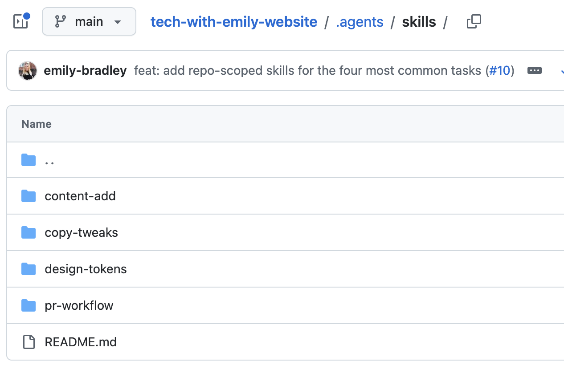
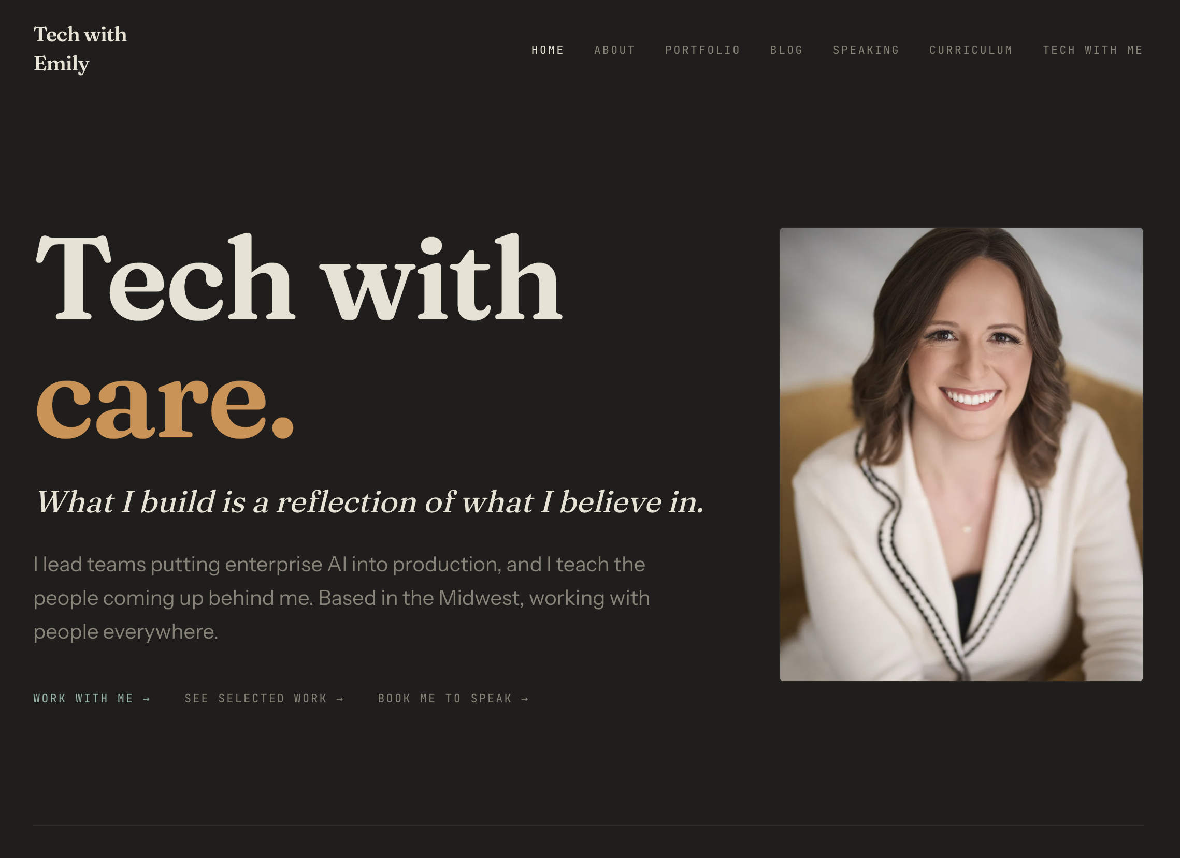
SECTION TWO · PLASMID, THE AGENT FLEET
I Built a Python Based Repository to Manage my Website
Agent skills in each repository inform and route agent interactions.
PLASMID
A private crew of autonomous coding agents that maintain repositories on my behalf.
Python 3.12
Claude Agent SDK
Docker
Azure Container Apps Jobs
Storage Queue
KEDA
THE CREW private, autonomous, unattended
IT READS THIS the four repo-scoped skills on main
AND THIS SHIPS techwithem.com, on Cloudflare
ONE RUN, START TO FINISH
1
ONE UNIT OF WORK
2
THE JOB STARTS
3
THE BUILDER
4
THE VERIFIER
5
THE GATE
One message, one change, one dollar ceiling.
The queue scales a container up. Python 3.12 on the Agent SDK.
Edits only inside its change class. No network, no GitHub.
A second agent, which did not do the work, checks it.
Nothing merges except through it.
Plasmid runtime and gate as described by its owner. Builder constraints quoted from plasmid/harness/builder.py. Screenshots: the repo's .agents/skills/ on main, and techwithem.com.
Notes:
Read it left to right. The crew wakes, it reads the four skills on main, and the site ships. The left box is just runtime: Python on the Agent SDK, in a container, started by a queue message through KEDA. The row underneath is one run. The two things worth saying out loud are the dollar ceiling, because an unbounded agent is a bill, and the verifier, because it is a different agent than the one that did the work. Land on the last line: the conventions live in the repo, not in the crew, so the same crew can be pointed at a repo it has never seen.

Slide 9
A High Level View of the Plasmid Team
Plasmid · an autonomous dev crew that lives outside the repository it maintains
THE CREW
Opus 5
Sonnet 5
Haiku 4.5
can block
PLAN
BUILD
GUARD
Dispatcher
Planner
Scout
Chief of Staff
Builder ×2
Triage
Reviewer
Warden
Librarian
takes your orders
plans the week
reads the field
writes your report
writes the code
fixes what breaks
checks the work
watches for trouble
keeps it readable
THE WORK LOOP · EVERY WEEKDAY, UNATTENDED
11
Queue
1 task, leased
Agent run
cold start
Pull request
preview deploy
Deploy
Cloudflare
Verify
in production
Live
DETERMINISTIC CHECKS
no agent may edit them
rollback, no model in the loop
RUNS ON AZURE · SCALES TO ZERO BETWEEN RUNS
Container Apps Jobs
Storage Queue + KEDA
Cosmos DB
Blob run journals
Key Vault + identity
9
11
0
~5M
SPECIALIZED ROLES
CHECKS BEFORE A MERGE
HUMAN APPROVAL STEPS
TOKENS A WEEK TO KEEP IT RUNNING
Notes:
One claim: agents are the cheap part, verification is the product. The gate is eleven deterministic scripts and no agent can edit it, which is what makes shipping without approval defensible rather than reckless. Circle fill shows model tier (solid teal = Opus 5, dark teal = Sonnet 5, hollow = Haiku 4.5). A green ring means that agent can stop the line. If asked why there is no approval step: blast radius is a broken marketing page for a few minutes, and rollback is automatic and non-agentic. If asked what would change my mind: the Reviewer is a model reviewing a model, and I have no evidence yet on how correlated their blind spots are. Nine roles, ten runners: Builder runs as two instances. Context is cleared of tool results at 100K tokens and compacted at 200K, and every run also carries a hard spend ceiling the SDK enforces across the subagent tree. Status Sept 2026: Phase 1 of 6.

Slide 10
SECTION TWO · THE REPO, techwithem.com
Skills in my Website Repo define how Agents Interact with it
THE STACK
Astro 5
MDX
TypeScript
Tailwind 4
Zod
sharp
Cloudflare Workers
wrangler
pnpm
Biome
ESLint
Prettier
Vitest
THE FOUR SKILLS · .agents/skills/
SKILL
WHAT IT IS
HOW IT HELPS
A RULE IT ENFORCES
copy-tweaks
136 lines
The rules for visible words, which no linter can hold.
Keeps voice steady whichever agent edits the copy.
Every heading ends with a period. No dashes. Write About and Contact in the first person.
pr-workflow
165 lines
The gate between a branch and main.
Seven checks in order, cheapest first, so a break surfaces fast.
One command checks the formatting, another one fixes it. Mixing the two up has cost this repo a CI run.
content-add
132 lines
How a post, a project, or an issue gets published.
Points at the runbook, then fills the gaps it went stale on.
A post summary runs 10 to 280 characters. Every newsletter issue carries a link out.
design-tokens
119 lines
How a color or a typeface changes safely.
Three files always move together, so dark mode never lands half-done.
Light and dark colors change in the same edit, so dark mode never breaks. No raw color codes in components.
Notes:
Move fast across the stack strip; it is there to establish that this is an ordinary TypeScript site, not a Python project. Then spend the time on the table. The fourth column is the one that lands: a rule a linter cannot express, taken from each skill. Headings end with a period. Format checks versus format writes. A dek between 10 and 280 characters. Close on the band: the skills are Markdown, they would work in any language, and the Python crew reads them from outside.

Slide 11
Context Is a Budget: The Problem Skills Solve
BEFORE SKILLS: TWO BAD OPTIONS
WHAT LOADS, VS WHAT LOADING IT ALL WOULD COST
Load everything, every turn
Everything loaded, every turn
~100,000 tokens
A CLAUDE.md that grew for two years. Every session pays for knowledge most turns never touch, and the rules at the bottom quietly stop being followed.
Tiered load, busiest turn
~4,800 tokens
1
Always resident
name + description, every skill
loads ~800 tokens (20 × ~40) · there is no larger version of this tier
Symptom: the agent obeys the top of your instructions and drifts from the bottom.
The price of admission, paid every turn. It buys the agent the ability to know a skill exists without reading it.
2
Loaded on trigger
the SKILL.md body, when matched
Load nothing, re-explain forever
loads ~3,000 tokens (1 body) · all 20 bodies would be ~60,000
Automatic, before work starts: the matched body enters context, the other nineteen stay on disk.
The agent guesses the test command, invents an API, reformats to a style the repo abandoned. Nothing you correct survives the session.
3
Read on demand
references/, scripts/, assets/
loads ~1,000 tokens (1 file) · all references would be ~40,000
Chosen mid-task: the body says “for rollbacks, see references/rollback.md” and the agent opens that file only if it hits that branch.
Symptom: the same four review comments, sprint after sprint.
Illustrative estimates for a 20-skill repo. The two bars share one scale; the three tier figures are the parts that add up to the ~4,800.
Notes:
The setup slide. Two pre-skill options both fail: everything resident (context bloat, deprioritized instructions, compaction dropping the tail) or nothing resident (the agent guesses and you re-explain every session).
The resolution is tiering. For a 20-skill repo, loading everything would be roughly 100,000 tokens on every turn; the tiered load is about 4,800 on the busiest turn and about 800 on a turn where nothing fires.
Trigger versus on demand: trigger is matching, decided before work starts, and pulls a whole SKILL.md body. On demand is navigation, decided mid-task, and pulls one named file only if that branch is taken.
That tiering is what makes a shelf of skills affordable, and it is also why an unproven skill still costs something: its description is resident on every turn.

Slide 12
SECTION THREE
What are Skills?
Notes:
Now the definition, a worked example, the setup, and the rules for a Python repo. If time is short, the two slides that matter are the definition and the rules panel.

Slide 13
SECTION THREE · WHAT IS A SKILL
A folder the agent opens only when it applies
ANATOMY: A DIRECTORY ON DISK
HOW IT LOADS: THREE LEVELS
run-tests/
SKILL.md the only required file
FIXTURES.md read on demand
REFERENCE.md
scripts/run_suite.py runs, never read
templates/test_case.py
1
METADATA
always on
~100 tokens
In the system prompt from the start. Claude matches your request against the description. Nothing else is visible.
2
SKILL.md BODY
on match
under 5k
---
name: run-tests
description: Runs this repo's suite the way CI does.
Use when tests, coverage or a failing
build are mentioned.
---
Read off disk when the description matches. It stays for the session.
3
FILES AND SCRIPTS
on demand
zero until used
The frontmatter is how the agent finds it. Below it, plain Markdown: the procedure, in the order you would explain it.
Reference files open when a condition calls them. Scripts return their output; the code never enters the window.
Resting cost is about a hundred tokens. Fifty skills fit without crowding the window.
AGENTS THAT READ IT
Claude Code
Codex CLI
Gemini CLI
Cursor
~40 clients, one format
Anthropic Agent Skills documentation: overview and frontmatter reference. Client support from the open specification at agentskills.io.
Notes:
One sentence to land: a skill is a folder, and the only part always in context is its name and description. Everything else is lazy. Point at the frontmatter panel and say that this is the only thing the model sees until it decides the skill applies, which is why the description is written for matching, not for reading.

Slide 14
SECTION THREE · AN EXAMPLE
My skill that helps me author skills
WHAT IT IS
HOW IT ROUTES
HOW IT CHECKS
A folder: one SKILL.md, five reference files, two scripts.
The last section of SKILL.md: a table naming each reference file and the condition that opens it, then the eight steps the skill runs.
Two scripts. Below is real output, run against the skill itself.
SKILL.md
---
name: skill-authoring
description: Turns a fuzzy "I want a
skill that does X" into a well-formed,
tested skill folder.
[...] Use whenever
the user asks to create, improve, test,
split, package, or debug a skill
[...]
even if they never say the word "skill".
---
# Skill authoring
Most requests that arrive here should not
become a skill in the shape the user first
described.
[...] Triage first, build second.
SKILL.md, last section
| File | Read when |
|---------------------|--------------------|
| triage-cases.md | user pushes back |
| elicitation.md | intent is fuzzy |
| runtime-matrix.md | it runs unattended |
| eval-loop-manual.md | no skill-creator |
| diagnosis.md | it isn't firing |
Step 0 Triage say no if it is not
Step 1 Locate route on what exists
Step 2 Elicit mine the transcript
Step 3 Structure resident or on demand
Step 4 Description draft three, pick one
Step 5 Baseline with it and without it
Step 6 Unattended nobody is watching
Step 7 Deliver skill, evals, reasons
$ python scripts/check_description.py .
OK 930 characters, under the 1024
limit.
OK Third person.
OK Opens with what the skill does.
OK States when to use it.
OK Includes an explicit push toward
triggering.
$ python scripts/validate_skill.py .
No errors. 0 warning(s).
THE BODIES OF KNOWLEDGE I PUT IN IT
ELICITATION 127
rules from an expert who does not notice them
TRIAGE 124
seven worked cases for not building
RUNTIME 138
what survives a move, and how unattended runs die
EVALUATION 170
running it against no skill, by hand
DIAGNOSIS 115
an ordered checklist for it isn't firing
THE SPEC, AS CODE 519
the caps and the rules, enforced not remembered
The skill-authoring skill as installed on this account. Both terminal blocks are real output, run on 8 September 2026. Long strings elided at [...].
Notes:
Walk the three panels left to right, then answer the two questions with the band. Panel one: the description is the only part always in context, and the last clause is the pushy one that catches people who never say the word skill. Panel two: one table keeps five more files out of the window until a condition calls them. Panel three is the payoff, real output, and the checker found a weak test prompt in the skill that ships the checker. Then the band: why a skill instead of a document, and the six bodies of knowledge inside. Note that only one of the six is about AI. The rest is interviewing, ops, and testing.

Slide 15
Writing Agent Skills That Live in a Python Repo
Repo-specific memory: what only this codebase can tell an agent, in under 500 lines.
ANATOMY ON DISK
1
Name it like a real request
2
Teach the repo, not Python
repo/
|-- pyproject.toml src/ tests/
`-- .claude/skills/
`-- run-migrations/
|-- SKILL.md <- the instructions
|-- references/ <- the background detail
| `-- rollback.md
|-- scripts/ <- deterministic work
| `-- verify_plan.py
`-- evals/evals.json
Third person, both halves, in the words of a real ask. Review both like code: an unvetted description is a prompt-injection vector.
Skip what any model already knows. Pin what it cannot guess: the commands that truly work here, package layout, fixture and factory conventions, migration order, which tests gate a merge.
3
Push determinism into scripts/
4
Start with something you repeat
FRONTMATTER THAT TRAVELS
Fragile or repeated steps become a script the prose calls. Handle errors inside it, exit non-zero, print the fix. Invoke through the project env (uv run, hatch run), never a bare python.
The steps you retype every sprint are the first skill worth writing. Watch what you explain twice, then write that down instead of explaining it again.
---
name:
run-migrations
description: Applies and verifies Alembic
migrations in this repo. Use when
the user mentions a migration, a
schema change, or "upgrade head".
allowed-tools: Bash, Read, Edit
---
5
Stay runtime-agnostic
6
Prove it against no skill *
Other agents read the file, not Claude's runtime. No shell injection, no ${CLAUDE_*} placeholders: they arrive as literal text elsewhere. Bundle a script and name paths from the repo root.
evals/evals.json: happy path, edge case, near-miss that must not fire. Run each twice in fresh sessions, with and without.
Only name, description, license, compatibility, metadata and allowed-tools are portable.
* Keeping the ones that fail is not free: a shelf of unproven skills degrades the ones that work.
LEAVE OUT restating PEP 8 and library docs · nested reference trees, which get partially read · ALWAYS and NEVER with no reason given · a menu of five libraries where one default and one escape hatch would do · dates and “as of” caveats that rot in place · one skill wearing two different triggers
Notes:
One-slide reference for authoring agent skills that ship inside a Python repository, readable by Claude or any other agent that loads SKILL.md.
Left column: the on-disk anatomy and the portable frontmatter subset. Right column: six authoring principles. Bottom: the unattended-run checklist and the common bloat to cut.
Key argument: a skill earns its permanent metadata cost only by carrying repo-specific truth the model cannot infer, and it is unproven until it has been run against a no-skill baseline in a fresh session.

Slide 16
What developers are loving about skills
arXiv 2602.08004 · arXiv 2607.18057
GitGuardian 2026 · Snyk ToxicSkills 2026
What the public catalogs and the measurement studies say people actually build.
WHAT PEOPLE BUILD, AND WHAT IT FIXES
• Infrastructure and DevOps. 24% of a 40,285-skill corpus, the largest slice by far
• Not committing a secret. Agent-assisted commits leak one 3.2% of the time, against a 1.5% baseline
• Tests that actually cover the change. 64.8% of agent Python PRs change code no existing test runs
• Debugging, linting and security review. 13% of the same corpus, third behind infra and code generation
• But read one before you install it. An audit of 22,511 public skills averaged 6.3 findings each
WHERE TO START read a library that already does it well: github.com/obra/superpowers TDD, brainstorming, subagent review, as skills.
Notes:
• This is the research answer to the discussion coming up: what people actually build skills for, not what a vendor page says they should.
• Infrastructure and DevOps is the largest slice of a 40,285-skill public corpus at 24%, ahead of code generation at 14%, and debugging and review at 13%.
• The two failure-driven ones are secrets and tests. Agent-assisted commits leak a credential at roughly double the public baseline, and most agent Python pull requests change code no existing test runs, so those are the first two skills most teams write.
• End on the caution. Public skills are executable supply chain: an audit of 22,511 of them averaged about six findings each. Read one before you install it.
• Every line on this slide links to its source if anyone asks in the room.

Slide 17
DISCUSSION
What are the most useful skills you’ve built, thought about building, or seen others leverage?
BUILT
THOUGHT ABOUT
SEEN ELSEWHERE
Notes:
Hold here. Take three or four answers out loud and write them on the board, because the honest ones will be more concrete than anything on the previous slides. If the room is quiet, prime it with the two from the setup slide: the credential rule and the test gate. The point to land afterwards is that every useful answer describes a failure someone already had, which is exactly where a skill comes from.

Slide 18
What's Next for AI: The Future of Context Management
THE CEILING
THE DISCIPLINE
WHAT'S NEXT
Bigger windows stopped paying
Write, select, compress, isolate
Context becomes a system
Window inflation: 13 models now ship 1M+ tokens. Usable quality holds to roughly 60-70% of the advertised number, then falls off a cliff.
Universal decay: every frontier model tested degrades as context grows. No exceptions.
Lost in the middle: over 30% accuracy drop when the needed fact sits mid-context.
Signal starvation: a typical 20K-token agent context carries about 2.5% relevant signal.
Four failure modes: poisoning, distraction, confusion, clash.
WRITE: state lives outside the window. Scratchpads, files, structured notes.
SELECT: just-in-time retrieval. Gate tools and memories, not just documents.
COMPRESS: compaction and hierarchical digests before the cliff, not after it.
ISOLATE: sub-agents with their own windows. Roughly 90% lift over single-agent on search-heavy work.
CACHE: stable prefixes remove 80-90% of input cost.
Memory as substrate: persistent store plus an adaptive selection engine, sitting outside the model.
Effective context replaces advertised context as the number that ships.
Benchmarks harden: LoCoMo, LongMemEval, BEAM. Best systems fall from 64.1 at 1M tokens to 48.6 at 10M.
Governed infrastructure: retention, lineage, staleness, consent.
Open frontier: temporal abstraction, cross-session identity, memory decay.
60-70%
30%+
2.5%
80-90%
of the advertised window that stays reliable
accuracy lost to mid-context placement
relevant signal in a typical agent context
input cost removed by cache-aligned context
Sources: Chroma context-rot study; Anthropic context engineering; Mem0 State of Agent Memory 2026; Breunig failure taxonomy
Notes:
Framing: three moves. (1) The ceiling: window size is no longer the constraint that matters; every model degrades well before its advertised limit, and effective context sits near 60-70% of the number on the box. (2) The discipline: write / select / compress / isolate is now the standard vocabulary for managing what enters the window, with sub-agent isolation and cache-aligned prefixes as the highest-leverage moves. (3) What's next: memory graduates from a retrieval trick to a system component with its own benchmarks (LoCoMo, LongMemEval, BEAM at 1M and 10M) and its own governance surface.
Sources: morphllm.com/context-rot; anthropic.com/engineering/effective-context-engineering-for-ai-agents; mem0.ai/blog/state-of-ai-agent-memory-2026; elvex.com/blog/context-length-comparison-ai-models-2026; reactify-solutions.com context engineering 2026.

Slide 19
THANK YOU
Any questions?
Presentation materials and an example of my skill-authoring skill will be on my website under speaking:
https://techwithem.com/speaking/
Notes:
Park anything you cannot answer on the board rather than guessing. The two questions that usually come up are how skills differ from CLAUDE.md, which is resident cost versus on-demand loading, and whether installing public skills is safe, which is the audit point from the setup slide.

Slide 20
REFERENCES
References
Agent Skills specification
Skills for enterprise
What developers build skills for
The format itself: directory rules, every frontmatter field, the limits.
Security review checklist, versioning, distribution, request caps.
40,285 public skills classified. Infrastructure 24%, code generation 14%.
agentskills.io/specification
platform.claude.com/…/agent-skills/enterprise
arxiv.org/abs/2602.08004
Skill authoring best practices
OWASP Agentic Skills Top 10
Test coverage in agent pull requests
Descriptions, scripts, anti-patterns, checklist.
The threat list for skill distribution and execution.
Where the test coverage figures on the chart slide come from.
platform.claude.com/…/agent-skills/best-practices
owasp.org/www-project-agentic-skills-top-10
arxiv.org/abs/2607.18057
Agent Skills overview
anthropics/skills
Merge rates for agent pull requests
What a skill is and how the three loading levels work.
Starter template and Anthropic's production document skills.
489 Python repos, 220,612 closed pull requests.
platform.claude.com/…/agent-skills/overview
github.com/anthropics/skills
arxiv.org/abs/2607.21832
Claude Code skills reference
More skills, worse agents? Skill shadowing
State of Secrets Sprawl 2026
Repository layout, precedence, and the Claude Code only fields.
Databricks, June 2026. The 202 skill library and the 21 percent drop.
GitGuardian. The 3.2% agent-assisted leak rate against a 1.5% baseline.
code.claude.com/docs/en/skills
arxiv.org/abs/2605.24050
blog.gitguardian.com/…/secrets-sprawl-2026
Skills explained, and steering Claude Code
How well do agentic skills work in the wild
What a security audit of public skills found
Skill against MCP, subagents, hooks, rules, and prompts.
UCSB, MIT CSAIL, MIT-IBM Watson. 34,198 real skills under noise.
22,511 skills, about 6.3 findings each. Read one before you install it.
claude.com/blog/skills-explained
arxiv.org/abs/2604.04323
thenewstack.io/ai-agent-skills-security
Also in your session: the skill-creator and skill-authoring skills. Their SKILL.md files are the best worked examples of the authoring slides.
Links verified September 2026. Named limits change; check the specification and the docs before quoting them.
Notes:
Start people at the specification and the best practices page. The two arXiv papers are the reason the deck argues for a small, sharp library rather than a large one. Anything numeric here should be re-checked before it is quoted in a design review.

Slide 21
AGENT SKILLS · STATE OF THE STANDARD · SEPTEMBER 2026
SKILL.md won: the format is settled, the supply chain is not
One folder with a markdown file now runs on roughly 40 agents. Portability is real; governance, provenance and review are still each vendor's problem.
THE FORMAT
WHERE IT RUNS
WHAT IS NOT STANDARDIZED
agentskills.io/specification
~40 shipping clients, one format
the part that reaches your risk committee
Unit is a folder: SKILL.md plus optional scripts/, references/, assets/.
Required frontmatter: name (1-64 chars, lowercase, hyphens, must match the directory) and description (1-1024 chars: what it does and when to use it).
Optional: license, compatibility, metadata map, allowed-tools (experimental, support varies).
Progressive disclosure: ~100 tokens of metadata at startup, full body on activation (under 5k tokens, 500 lines), references only on demand.
CI hook: skills-ref validate ./my-skill
Anthropic: Claude, Claude Code (~/.claude/skills). OpenAI: Codex CLI and ChatGPT (~/.codex/skills, plus openai.yaml). Google: Gemini CLI. Microsoft: Copilot and VS Code. Cursor: project scope only.
Beyond coding: Databricks Genie Code, Snowflake Cortex Code, Pulumi Neo, goose, OpenHands, Letta, Factory, Kiro, Tabnine, Spring AI, Laravel Boost.
What does not travel: context isolation, subagents, allowed-tools, vendor metadata. Write to the core, test on each harness.
Governance: open standard published Dec 19, 2025. MCP, AGENTS.md and goose sit under the Linux Foundation's Agentic AI Foundation; Agent Skills does not.
Absent from the spec: versioning, signing, provenance, dependency pinning, rollback, permissions beyond one experimental field.
Snyk ToxicSkills, Feb 2026: 3,984 public skills scanned; 36% carried a security flaw, 13.4% critical, 76 confirmed malicious, 91% of those using prompt injection.
So: a skill is executable supply chain. Review it like a dependency, not like a doc.
WHERE THE GOOD SKILLS ACTUALLY LIVE
GitHub stars, rounded, Sept 2026
REPOSITORY | WHAT IT IS | WHY IT MATTERS | STARS
obra/superpowers | Methodology as skills: TDD, brainstorming, subagent-driven review | The reference for skills that enforce a process. MIT, 14 harnesses | ~283k
anthropics/skills | Anthropic's reference skills, spec copy and skill template | docx / pptx / xlsx / pdf: best worked examples of a complex skill | ~169k
agentskills/agentskills | The specification itself, plus the skills-ref validator | What you cite in a standard, and what you wire into CI | ~21k
obra/superpowers-skills, -marketplace | Community-editable library plus its curated marketplace | The distribution pattern: governed marketplace over open library | -
travisvn/awesome-claude-skills | Curated index of official and community skills, plus guides | Fastest survey of what exists before you write another one | ~15k
laravel/boost, expo/skills, Trail of Bits | Vendor and specialist skills for their own tools | Closest thing to trusted supply: API owners own the skill | -
Sources: agentskills.io specification and client showcase; agentskills/agentskills; Anthropic open-standard release, Dec 19 2025; Linux Foundation AAIF launch, Dec 9 2025; Snyk ToxicSkills study, Feb 5 2026; GitHub repository pages.
Notes:
Framing: the interesting thing is not that skills exist, it is how fast the format settled. Anthropic published the spec as an open standard on Dec 19 2025; OpenAI shipped support within a day; by now roughly forty clients read the same folder.
Card 1: the whole spec fits on a card. Two required fields. The engineering discipline is progressive disclosure: name and description are always in context, so the description is the retrieval interface, not documentation. Most bad skills are bad because the description does not say when to use them.
Card 2: portability is real for the core and thin at the edges. A skill that leans on subagents, context isolation or allowed-tools behaves differently on Cursor than on Claude Code. Cursor is project scope only, which matters if you were planning to distribute personal skills.
Card 3: this is the slide's argument. The format converged; the trust layer did not. MCP went to the Linux Foundation, Agent Skills did not, so there is no neutral steward yet. The spec has no signing, versioning or provenance. Snyk scanned 3,984 public skills and found 36 percent with at least one flaw and 76 confirmed malicious. A skill is markdown that tells an agent holding your credentials what to do. Treat it as a dependency: pinned source, review, allowlist.
Repo table: superpowers is worth studying even if you never install it, because it encodes a methodology rather than a lookup. The anthropics/skills document skills are the best example of a large skill that stays inside a context budget. Point people at agentskills/agentskills for the validator.
Star counts are rounded snapshots from September 2026; refresh before presenting.

Slide 22
WHAT THE EVIDENCE SAYS
Skills do not scale for free
21%
38.4%
31%
pass rate lost
down from 55.4%
of runs loaded them
when a 202-skill library replaced the known-good set. Skill shadowing explained up to 68% of the drop; the larger context itself was indistinguishable from noise.
for Claude Opus once curated skills were removed from a pool of 34,198 real skills. The no-skill baseline was 35.4%. Two weaker models scored lower with skills than without.
when distractor skills were added, down from 49% with the right skills present and no distractors. Retrieval, not context size, is the bottleneck.
Databricks, arXiv 2605.24050
UCSB, MIT CSAIL, MIT-IBM Watson
Same study, arXiv 2604.04323
What this changes: cap the loaded set and scope it by role, the API allows 20 skills per request. Keep descriptions disjoint and keep a near-miss test for each one. When two skills compete for the same request, merge them or narrow one.
Sources: arXiv 2605.24050 (Databricks, June 2026); arXiv 2604.04323 (UCSB, MIT CSAIL, MIT-IBM Watson AI Lab); Skills for enterprise, docs.claude.com.
Notes:
This is the slide that should change behavior. The instinct after learning to write skills is to write many. The measured effect of a large, overlapping library is negative, and the mechanism is selection, not context. A library of twelve sharp skills beats two hundred fuzzy ones.

